Slide 1

Blockchain Based Web Framework for Property Registration
Group No. 1
Amit Pandey 18104020
Aditya Shinde 18104032
Rajan Khade 18104020
Project Guide and Coguide
Prof. Neha Deshmukh and Prof. Vidya Shet

Slide 2
Contents
Introduction
Objectives
Problem Definition
Technological Stack
Review Suggestions
Proposed System Architecture/Working
Prototype Design Demonstration
Implementation Status
Status of Paper Draft & Targeted Conference

Slide 3
Introduction
Problem Identified :
  The Involvement of middlemen and brokers.
  The increasing number of fraud cases.
  Time Delays and lack of digital protection.
  Tax and registration charges.
Solution Proposed :
  Blockchain based Platform using Hyperledger Fabric.
  Migrate existing data to smart contract.
  Storing sensitive data and documents’ hash in Smart Contract (and decentralized storage).
  Charges in the form of transaction fees for each operation and Direct buying and selling, without middleman.

Slide 4
Objectives
To make process faster and bring transparency with use of blockchain.
To Reduce the fraud cases.
To reduce extra charges.
To develop a Web Application, which will directly connect user to the blockchain.

Slide 5
Technological Stack
Backend – Hyperledger fabric, NodeJS
Frontend - React.js, CSS, JavaScript
Database - IPFS Storage
Server Side Frameworks - Express.js

Slide 6
Review Suggestions
To change the technology from Ethereum to Hyperledger fabric.
To add a Government Entity in the process.

Slide 7
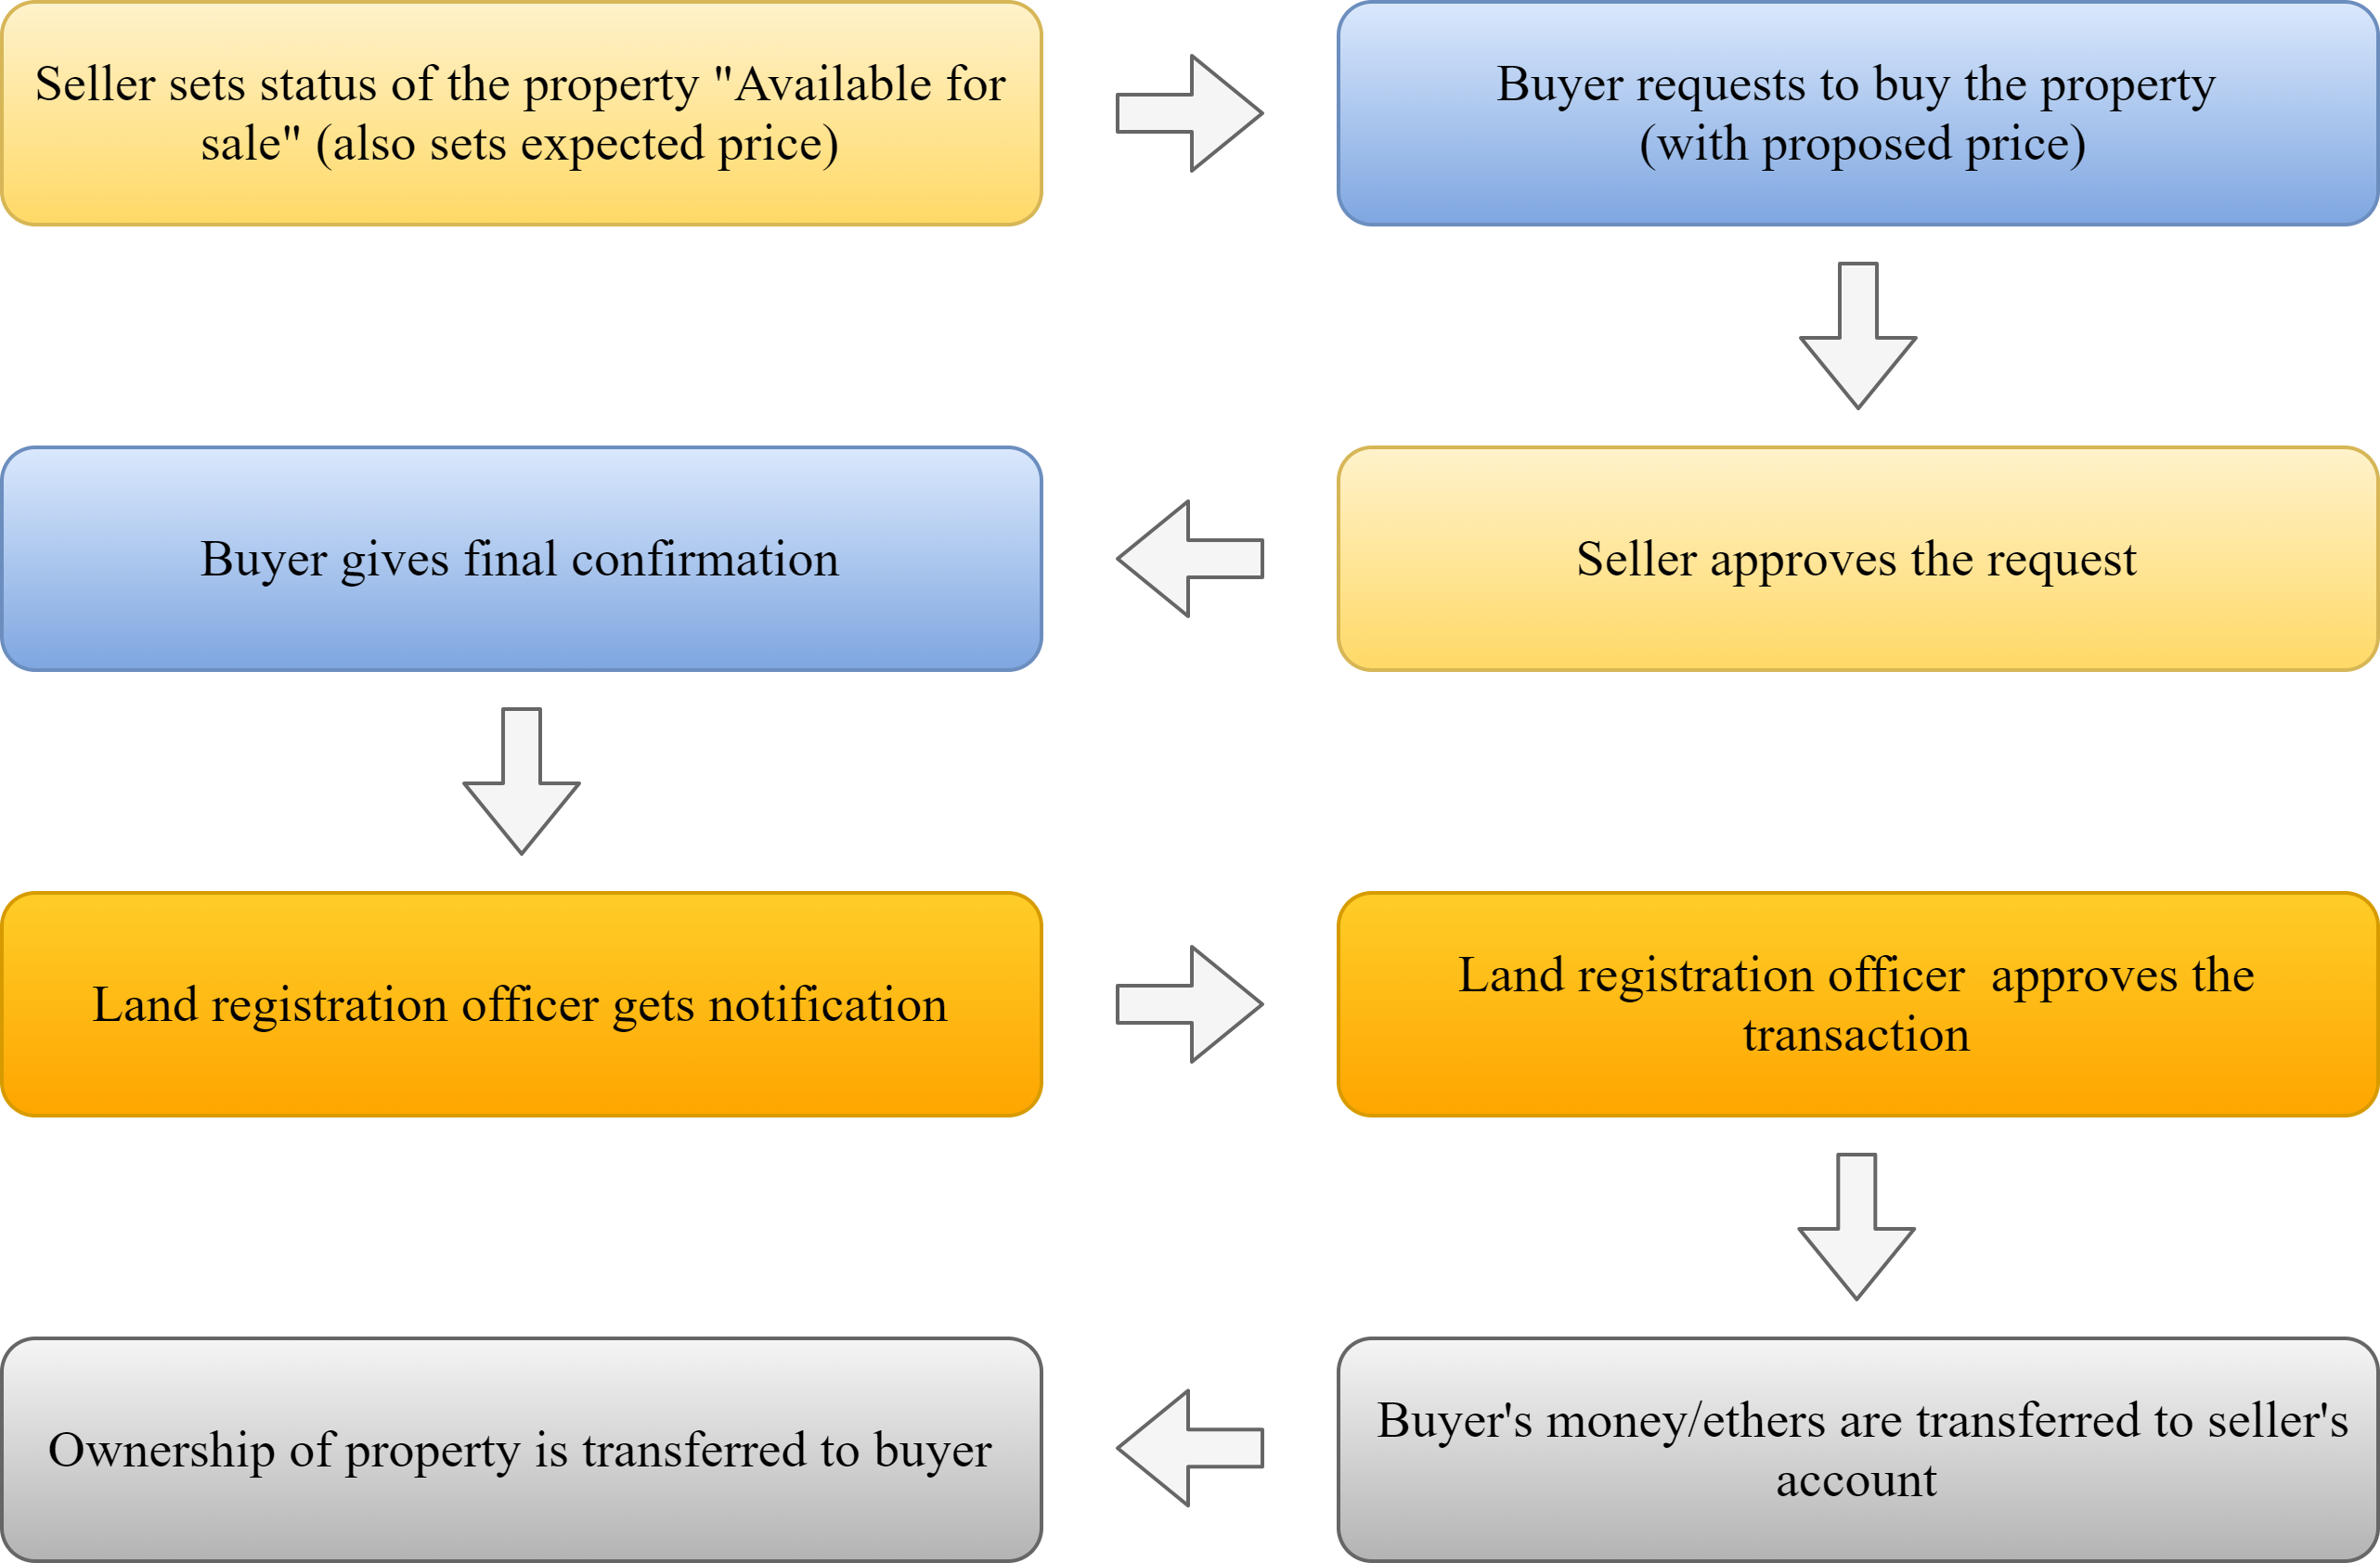
Proposed System Architecture
Figure 6.2: New system (After migration), each step is function of smart contract.

Slide 8
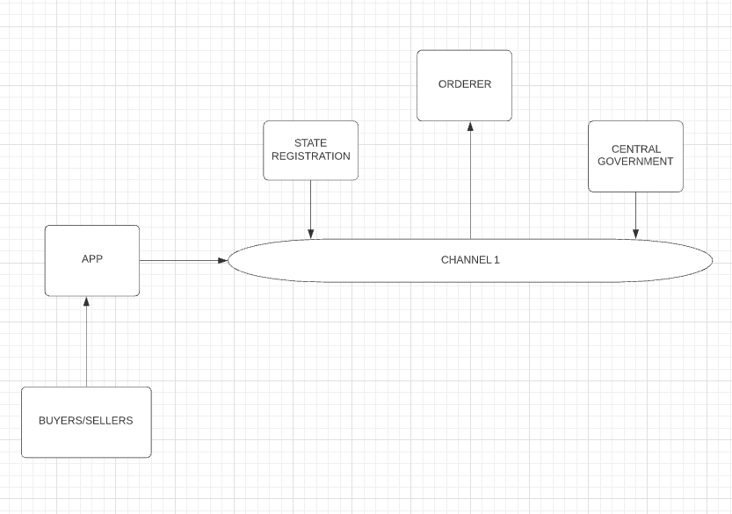
Prototype Design Demonstration

Slide 9
Implementation Status
Basic functionalities of smart contract are done
Working on remaining functionlities

Slide 10
Status of Paper Draft & Targeted Conference
Targeted Conferences
  IEEE 2021 International Conference on Advances in Computing, Communication and Control, 3rd and 4th December 2021
  IEEE International Conference on Computational Intelligence and Computing Applications, 26th and 27th November 2021

Slide 11
Thank You...!!

